Slide 1
Pilot Stress Detection Through Physiological Signals Using a Transformer-Based Deep Learning Model
IEEE Sensors Journal, 2023
Cited by: 22
Presenter: Nooshin Taheri
8/14/2025

Slide 2
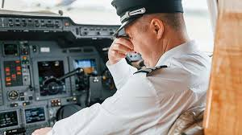
Why Detecting Pilot Stress Matters
Pilot stress detection is crucial for flight safety and performance.
High automation + fewer crew members → pilots must handle multiple simultaneous tasks, leading to increasing stress.
Pilot high stress leads to:
Poor decision-making
Reduced situational awareness
Decreased performance
Early detection enables flight systems to adjust workload and prevent performance decline during acute stress events.
With wearable physiological sensors and AI, stress can now be detected in real time.

Slide 3
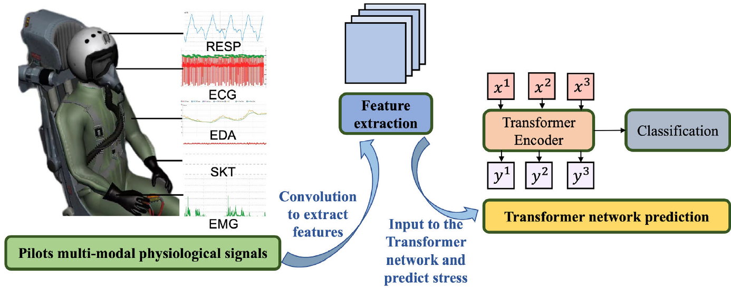
Aim of This Study
Detect pilot stress caused by mission difficulty or abnormal flight conditions using multimodal physiological signals.
Signals chosen for portability & effectiveness:
Electrocardiography (ECG)
Electromyography (EMG)
Electrodermal activity (EDA)
Respiration (RESP)
Skin temperature (SKT)
Contribution of the study:
Novel CNN + Transformer architecture
CNN module → extracts local features and patterns within each signal.
Transformer module → captures global dependencies and relationships between multiple signals.

Slide 4
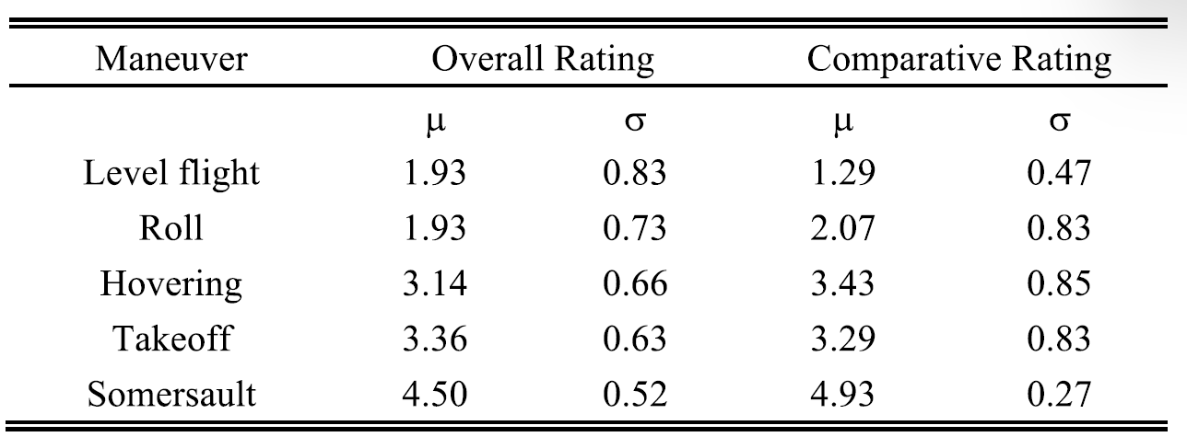
Experiment Protocol
Participants: 14 professionally trained flight cadets
Equipped with wearable physiological measurement devices.
Completed State-Trait Anxiety Inventory (STAI-Y1) to confirm stress-free baseline.
Five maneuvers performed in the simulator (Takeoff, Level flight, Roll, Hovering, Somersault)
Stress Assessment
Questionnaire after each maneuver
Overall Rating (OR): 1 = No stress, 5 = High stress
Comparative Rating (CR): Rank maneuvers by stress level
Scores are standardized using Z-score
The mean and standard deviation of the scores were calculated

Slide 5
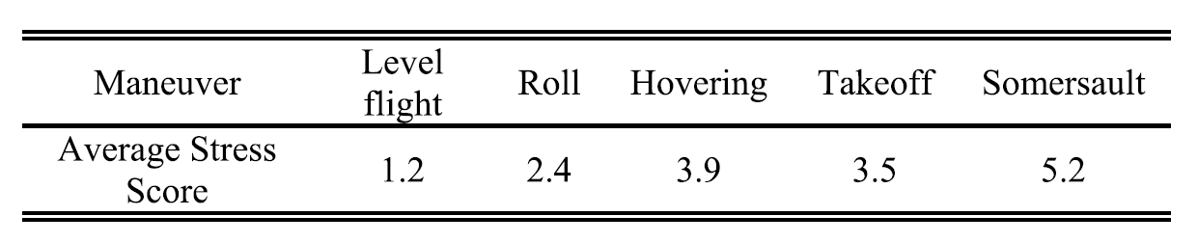
Labeling Method
Stress score computed per second based on:
Aircraft attitude change
G-force variation
Skin conductance variation
Classes defined:
2-class: Low vs High stress
3-class: Low, Medium, High stress
4-class: None, Low, Medium, High stress
G-force is the acceleration of an object relative to the Earth’s gravitational force, which is output by the flight simulation software.
Results exceeded the acceptable threshold.
This shows the scoring method is feasible and produced consistent results agreed upon by all scorers.
Verification:
Average stress scores for each maneuver were calculated.

Slide 6
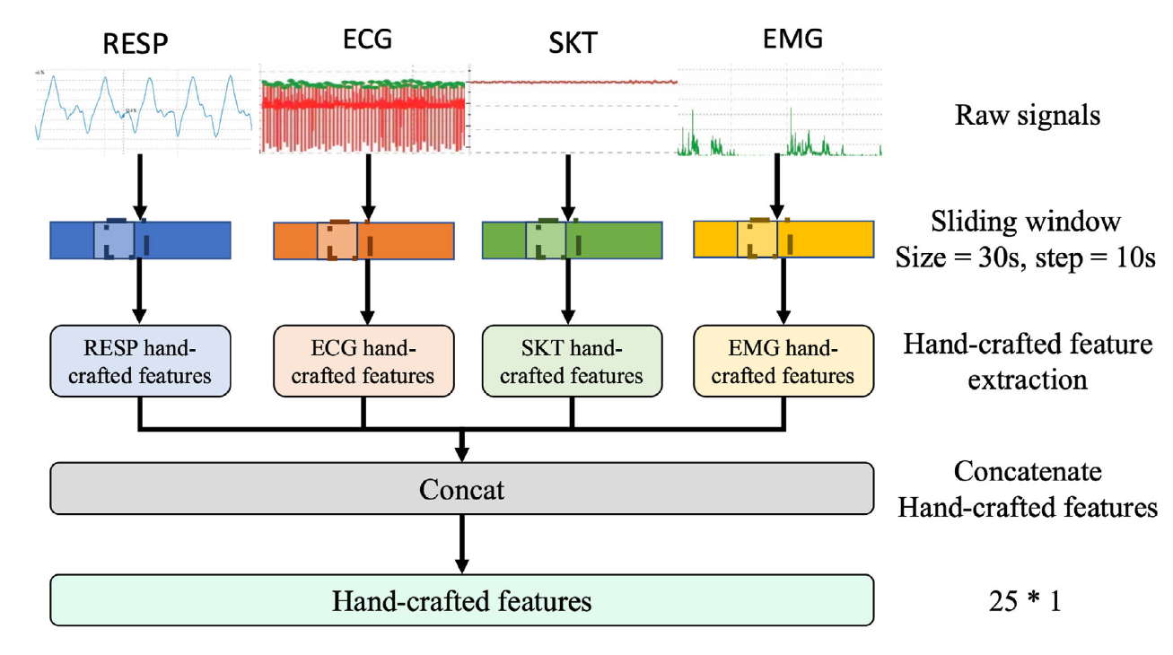
Data Processing & Features
Preprocessing:
Handle missing data (interpolation filling)
denoising (wavelet, filtering)
Features:
Handcrafted (25 features per time window):
ECG/HRV: Heart rate, NN intervals, SDNN, RMSSD, pNN50, pNN20, VLF, ULF, LF, HF, LF/HF ratio
EMG: Voltage mean, std, RMS, integral EMG, median frequency, mean power frequency
RESP: Respiratory rate (mean, std), respiration power
SKT: Skin temperature
Deep features: Extracted via CNN layers.

Slide 7
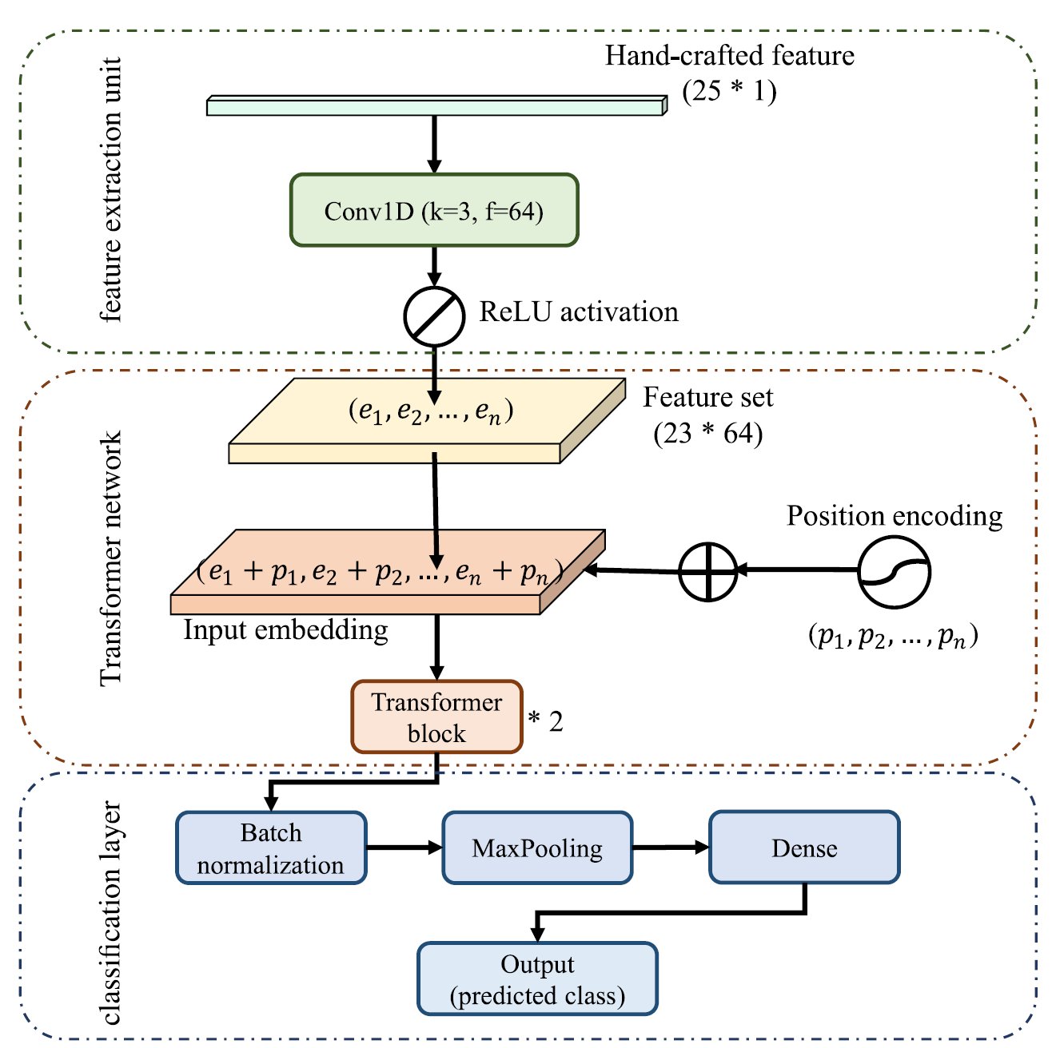
Model Architecture
Pipeline:
Feature Extraction Unit – 1D CNN → captures local patterns. (extract hidden features)
Transformer Block – self-attention → models dependencies between modalities.
Classification Layer – predicts stress level.
Due to the relatively few features and the individual differences between subjects, dropout is replaced by layer normalization (LN) and regularization.
more attention would be paid to positions with higher activation.

Slide 8
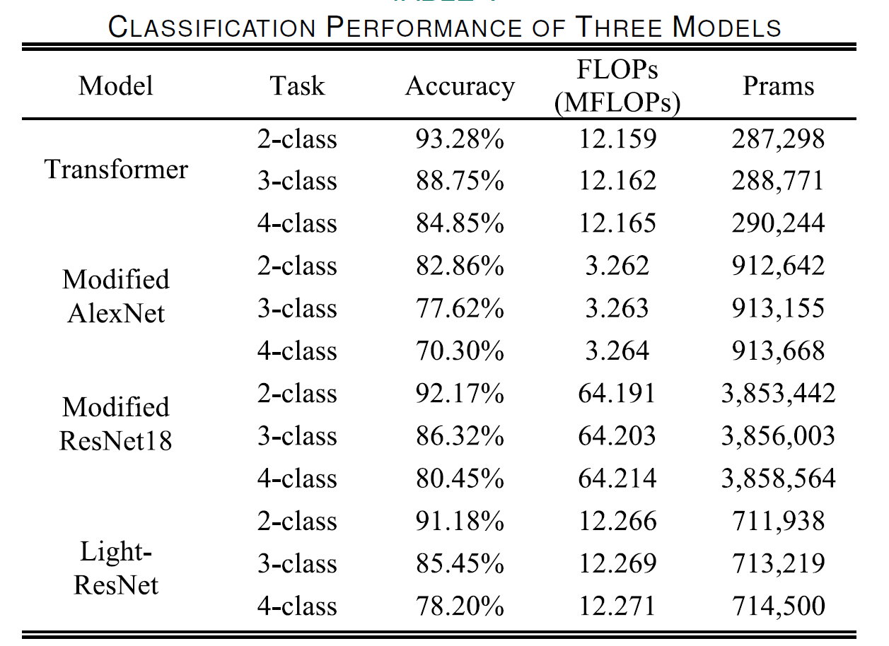
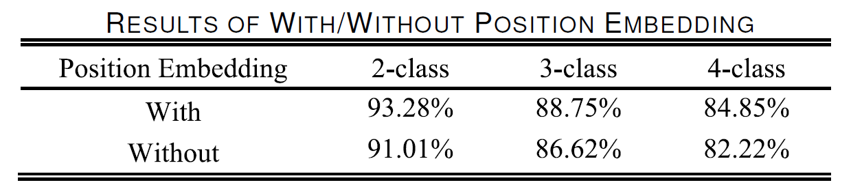
Results
Baseline Models Compared
Modified AlexNet (1D conv layers for signals)
Modified ResNet18
Light-ResNet (simplified ResNet for fairness in computation)
All models evaluated with 10-fold cross-validation.
A higher number of classes increases difficulty, but the transformer advantage grows.
Comparable performance to ResNet18 but with faster training.
Position embedding improves accuracy

Slide 9
Discussion
Transformer module captures dependencies between multimodal physiological signals better than CNN alone.
Feature extraction unit (handcrafted + CNN deep features) improves accuracy by:
Representing both time-domain and frequency-domain info.
Capturing local correlations before transformer processing.
Position embedding:
Encodes location info of features.
Attention mechanism:
Focuses on global relationships.
The transformer’s attention mechanism can directly link any two points in a signal, no matter how far apart they are, making it easier to spot relationships between events separated in time.

Slide 10
Conclusion
Developed a CNN + Transformer model for detecting pilot stress from multimodal physiological signals (ECG, EMG, EDA, RESP, SKT).
CNN extracts local patterns; Transformer captures global relationships between different signals.
Achieved high accuracy: 93.28% (2-class), 88.75% (3-class), 84.85% (4-class), outperforming AlexNet and matching or exceeding ResNet18 with faster training.
Combining handcrafted features with deep-learned features improves robustness.
Position embedding and attention mechanism are key for performance.
Potential use: real-time pilot stress monitoring to enhance safety and decision-making.

